Slide 1
AI-Competency Training (ACT)
Building future-ready AI skills across Aaseya

Slide 2
Course Summary:
Descriptive Statistics: Getting a better sense of data
Mean, Standard Deviation, Median, Quartiles, Distribution
Inferential Statistics: Drawing conclusions about the population based on sample data
Properties of a single variable
Book for the Course:
Textbook is much more exhaustive than what we will cover in five weeks
The Best use of the book is as a reference, go to specific sections of chapter where you need more clarity

Slide 3
Definitions:
It is a science which helps us to collect, analyze and present data systematically.
It is the process of collecting, processing, summarizing, presenting, analysing and interpreting of data in order to study and describe a given problem.
Statistics is the art of learning from data.
Statistics may be regarded as:
the study of populations,
the study of variation, and
the study of methods of the reduction of data.

Slide 4
Importance of Statistics:
It simplifies mass of data (condensation)
Helps to get concrete information about any problem
Helps for reliable and objective decision making
It presents facts in a precise & definite form
It facilitates comparison(Measures of central tendency and measures of dispersion)
It facilitates Predictions (Time series and regression analysis are the most commonly used methods towards prediction.)
It helps in formulation of suitable policies
Limitations of Statistics:
Statistics does not deal with individual items;
Statistics deals only with quantitatively expressed items it does not study qualitative phenomena;
Statistical results are not universally true;
Statistics is liable/responsible/ to be misused.

Slide 5
Application areas of statistics:
Engineering:
Improving product design, testing product performance, determining reliability and maintainability, working out safer systems of flight control for airports, etc.
Business:
Estimating the volume of retail sales, designing optimum inventory control system, producing auditing and accounting procedures, improving working conditions in industrial plants, assessing the market for new products.

Slide 6
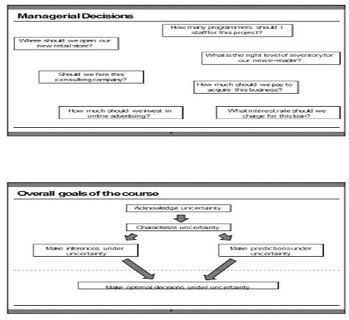

Slide 7
Quality Control:
Determining techniques for evaluation of quality through adequate sampling in process control consumer survey and experimental design in product development etc.
*Realizing its importance, large organizations are maintaining their own Statistical Quality Control Department.*
Economics:
Measuring indicators such as volume of trade, size of labor force, and standard of living, analyzing consumer behavior, computation of national income accounts, formulation of economic laws, etc.
*Particularly, Regression analysis extensively uses in the field of Economics*.

Slide 8
Health and Medicine:
Developing and testing new drugs, delivering improved medical care, preventing diagnosing, and treating disease, etc. Specifically, inferential Statistics has a tremendous application in the fields of health and medicine.
Biology:
Exploring the interactions of species with their environment, creating theoretical models of the nervous system, studying genetically evolution, etc.
Psychology:
Measuring learning ability, intelligence, and personality characteristics creating psychological scales and abnormal behaviour, etc
Sociology:
Testing theories about social systems, designing and conducting sample surveys to study social attitudes, exploring cross-cultural differences, studying the growth of human population, etc.

Slide 9
There are two main branches of statistics:
Descriptive statistics
Inferential statistics
1. Descriptive statistics:
It is the first phase of Statistics;
Involve any kind of data processing designed to the collection, organization, presentation, and analyzing the important features of the data with out attempting to infer/conclude any thing that goes beyond the known data.
In short, descriptive Statistics describes the nature or characteristics of the observed data (usually a sample) without making conclusion or generalization.

Slide 10
The following are some examples of descriptive Statistics:
The daily average temperature range of AA was 25 0c last week .
The maximum amount of coffee export of Eth. (as observed from the last 20 years) was in the year 2004.
The average age of athletes participated in London Marathon was 25 years.
75% of the instructors in AAU are male.
The scores of 50 students in a Mathematics exam are found to range from 20 to 90.

Slide 11
2. Inferential statistics (Inductive Statistics):
It is a second phase of Statistics which deals with techniques of making a generalization that lie outside the scope of Descriptive Statistics;
It is concerned with the process of drawing conclusions (inferences) about specific characteristics of a population based on information obtained from samples;
It is a process of performing hypothesis testing, determining relationships among variables, and making predictions.
The area of inferential statistics entirely needs the whole aims to give reasonable estimates of unknown population parameters.

Slide 12
The following are some examples of inferential Statistics:
The result obtained from the analysis of the income of 1000 randomly selected citizens in Ethiopia suggests that the average monthly income of a citizen is estimated to be 600 Birr.
Here in the above example, we are trying to represent the income of about entire population of Ethiopia by a sample of 1000 citizens, hence we are making inference or generalization.
Based on the trend analysis on the past observations/data, the average exchange rate for a dollar is expected to be 18 birr in the coming month.
The national statistical Bureau of Ethiopia declares the outcome of its survey as “The population of Eth. in the year 2020 will likely to be 120,000,000.”
From the survey obtained on 15 randomly selected towns of Eth. it is estimated that 0.1% of the whole urban dwellers are victims of AIDS virus.

Slide 13
Exercise: Descriptive Statistics or Inferential Statistics:
The manager of quality control declares the outcome of its survey as “the average life span of the imported light bulbs is 3000 hrs.
Of all the patients taking the drug at a local health center 80% of them suffer from side effect developed.
The average score of all the students taking the exam is found to be 72.
The national statistical bureau of Eth. declares the outcome of its survey for the last 30 years as “the average annual growth of the people of Ethiopia is 2.8%.
The national statistical bureau of Eth. declares the outcome of its survey for the last 30 years as “the population of Ethiopia in the year 2015 will likely to be 100,000,000.
Based on the survey made for the last 10 years 30,000 tourists are expected to visit Ethiopia.
Based on the survey made for the last 20 years the maximum number of tourists visited Eth. were in the year 1993.
The Ethiopian tourism commission has announced that (as observed for the last 20 years) the average number of tourists arrived Ethiopia per year is 3000.
The maximum difference of the salaries of the workers of the company untilthe end of last year was birr 5000.

Slide 14
Main terms in statistics:
Data:
Certainly, known facts from which conclusions may be drawn.
Statistical Data:
Raw material for a statistical investigation which are obtained when ever measurements or observations are made.
Quantitative data: data of a certain group of individuals which is expressed numerically. Example: Heights, Weights, Ages etc. of a certain group of individuals.
Qualitative data: data of a certain group of individuals that is not expressed numerically. Example: Colors, Languages, Nationalities, Religions, health, poverty etc of a certain group of individuals. Primary data and Secondary data

Slide 15
Main terms in statistics:
Data: Certainly, known facts from which conclusions may be drawn.
Statistical Data:
Raw material for a statistical investigation which are obtained when ever measurements or observations are made.
Quantitative data: data of a certain group of individuals which is expressed numerically. Example: Heights, Weights, Ages etc. of a certain group of individuals.
Qualitative data: data of a certain group of individuals that is not expressed numerically. Example: Colors, Languages, Nationalities, Religions, health, poverty etc of a certain group of individuals. Primary data and Secondary data
Variable: A variable is a factor or characteristic that can take on different possible values or outcomes. A variable can be qualitative or quantitative (numeric). Example: Income, height, weight, sex, age, etc of a certain group of individuals are examples of variables.

Slide 16
Population: A complete set of observation(data) of the entire group of individuals under consideration. A population can be finite or infinite. Example: The number of students in this class, the population in Addis Ababa etc.
Sample: A set of data drawn from population containing a part which can reasonably serve as a basis for valid generalization about the population. A sample is a portion of a population selected for further analysis.
Sample size: The number of items under investigation in a sample.
Survey (experiment): it is a process of obtaining the desired data. Two types of survey:
Census Survey: A way of obtaining data referring the entire population including a total coverage of the population.
Sample Survey: A way of obtaining data referring a portion of the entire population consisting only a partial coverage of the population.

Slide 17
STEPS/STATISTICAL INVESTIGATION:
Collection of Data: Data collection is the process of gathering information or data about the variable of interest. Data are inputs for Statistical investigation. Data may be obtained either from primary source or secondary source.
Organization of Data: Organization of data includes three major steps.
Editing: checking and omitting inconsistencies, irrelevancies.
Classification : task of grouping the collected and edited data .
Tabulation: put the classified data in the form of table.
Presentation of Data: The purpose of presentation in the statistical analysis is to display what is contained in the data in the form of Charts, Pictures, Diagrams and Graphs for an easy and better understanding of the data.

Slide 18
Analyzing of Data:
In a statistical investigation, the process of analyzing data includes finding the various statistical constants from the collected mass of data such as measures of central tendencies (averages) , measures of dispersions and soon.
It merely involves mathematical operations different measures of central tendencies (averages), measures of variations, regression analysis etc. In its extreme case, analysis requires the knowledge of advanced mathematics.
5. Interpretation of Data:
involve interpreting the statistical constants computed in analyzing data for the formation of valid conclusions and inferences.
It is the most difficult and skill requiring stage.
It is at this stage that Statistics seems to be very much viable to be misused.
Correct interpretation of results will lead to a valid conclusion of the study and hence can aid in taking correct decisions.
Improper (incorrect) interpretation may lead to wrong conclusions and makes the whole objective of the study useless.

Slide 19
THE ENGINEERING METHOD AND STATISTICAL THINKING
An engineer is someone who solves problems of interest to society by the efficient application of scientific principles
Engineers accomplish this by either refining an existing product or process or by designing a new product or process that meets customers’ expectations and needs.
The steps in the engineering method are as follows:
Develop a clear and concise description of the problem.
Identify, the important factors that affect this problem or that may play a role in its solution.
Propose a model for the problem, using scientific or engineering knowledge of the phenomenon being studied. State any limitations or assumptions of the model.
Conduct appropriate experiments and collect data to test or validate the tentative model or conclusions made in steps 2 and 3.

Slide 20
Cont’d:
Refine the model on the basis of the observed data.
Manipulate the model to assist in developing a solution to the problem.
Conduct an appropriate experiment to confirm that the proposed solution to the problem is both effective and efficient.
Draw conclusions or make recommendations based on the problem solution.
The engineering method features a strong interplay between the problem, the factors that may influence its solution, a model of the phenomenon, and experimentation to verify the adequacy of the model and the proposed solution to the problem.
Specifically, statistical techniques can be a powerful aid in designing new products and systems, improving existing designs, and designing, developing, and improving production processes.
Therefore, Engineers must know how to efficiently plan experiments, collect data, analyze and interpret the data, and understand how the observed data are related to the model that have been proposed for the problem under study.

Slide 21
1.2. Data collection and graphical representation of data
Classification of Data based on source:
Primary: data collected for the purpose of specific study.
It can be obtained by:
Direct personal observation
Direct or indirect oral interviews
Administrating questionnaires
Secondary: refers to data collected earlier for some purpose other than the analysis currently being undertaken. It can be obtained from:
External Secondary data Sources( for eg. gov’t and non gov’t publications)
Internal Secondary data Sources: the data generated within the organization in the process of routine business activities
Qualitative data are nonnumeric. Quantitative data are numeric.

Slide 22
1.2. Data collection and graphical representation of data
Classification of Data based on source:
Primary: data collected for the purpose of specific study.
It can be obtained by:
Direct personal observation
Direct or indirect oral interviews
Administrating questionnaires
Secondary: refers to data collected earlier for some purpose other than the analysis currently being undertaken. It can be obtained from:
External Secondary data Sources( for eg. gov’t and non gov’t publications)
Internal Secondary data Sources: the data generated within the organization in the process of routine business activities
Qualitative data are nonnumeric. Quantitative data are numeric.

Slide 23
Method of data presentation
The purpose of organizing data is to see quickly some of the characteristics of the data that have been collected.
Raw data is collected numerical data which has not been arranged in order of magnitude.
An array is an arranged numerical data in order of magnitude.
Mechanism for reducing and summarizing data are:
Tabular method.
Graphical method
Diagrammatic method

Slide 24
1.Tabular presentation of data:
The collected raw data should be put into an ordered array in either ascending or descending order so that it can be organized into a Frequency Distribution (FD)
Numerical data arranged in order of magnitude along with the corresponding frequency is called frequency distribution (FD).
FD is of two kinds namely ungrouped /and grouped frequency distribution
A. Ungrouped (Discrete) Frequency Distribution
It is a tabular arrangement of numerical data in order of magnitude showing the distinct values with the corresponding frequencies.
Example: Suppose the following are test score of 16 students in a class, write ungrouped frequency distribution. “14, 17, 10, 19, 14, 10, 14, 8, 10, 17, 19, 8, 10, 14, 17, 14”
Sol: the ungrouped frequency distribution: Array: 8,8,10,10,10,10,14,14,14,14,14, 17,17,17,19,19.
Then the ungrouped frequency distribution is then grouped:-
The difference between the highest and the lowest value in a given set of observation is called the range (R) R= L- S, R= 19-8 = 11
Test Score | 8 | 10 | 14 | 17 | 19
Frequency | 2 | 4 | 5 | 3 | 2

Slide 25
B.Grouped (continuous) Frequency Distribution (GFD)
It is a tabular arrangement of data in order of magnitude by classes together with the corresponding class frequencies.
Inorder to estimate the number of classes, the ff formula is used:
Number of classes=1+3.322(log N) where N is the Number of observation.
The Class size = Range (Round up)
(class width) 1+3.322(log N)
Example: Grouped/Continuous frequency distribution where several numbers are grouped into one class.
Students Age | Frequency
18-25 | 5
26-32 | 15
33-39 | 10

Slide 26
Components of grouped frequency distribution
Lower Limit: is the smallest number that can actually belong to the respective classes.
Upper Class Limit: is the largest number that can actually belong to the respective classes.
Class Boundaries: are numbers used to to separate adjoining classes which should not coincide with the actual observations.
Class Mark: is the midpoint of the class
Class Width/Class Intervals: is the difference between two consecutive lower-class limits or the two consecutive upper-class limits. (OR) can be obtained by taking the difference of two adjoining class marks or two adjoining lower-class boundaries.
Class width = Range/Number of class desired.
Where: Number of classes=1+3.322(log N) where N is the Number of observation.

Slide 27
6. Unit of measure: is the smallest possible positive difference between any two measurements in the given data set that shows the degree of precision.
7. Class boundaries: can be obtained by taking the averages of the upper-class limit of one class and the lower-class limit of the next class.
8. Lower class boundaries: can be obtained by subtracting half a unit od measure from the lower-class limits.
9. Lower Class Boundaries: can be obtained by adding half the unit of measure to the upper class limits.
Example:Suppose the table below is the frequency distribution of test score of 50 students. Then the frequency table has 6 classes (class intervals).

Slide 28
Example:Suppose the table below is the frequency distribution of test score of 50 students. Then the frequency table has 6 classes (class intervals).
What is the Unit of Measure, LCLs, UCLs, LCBs, UCBs, CW, and CM
The unit of measure is 1
The lower-class limits are:-11, 16, 21, 26, 31, 36
The upper-class limits are:- 15, 20, 25, 30, 35, 40
The class marks are:- 13((11+15)/2), 18, 23, 28, 33, 38
The lower-class boundaries are:- 10.5(11-0.5), 15.5, ….,35,5
The upper-class boundaries are:- 15.5(15+0.5), ….35.5,40.5
Class width (size) is 5.
Test Score | Frequency
11-15 | 7
16-20 | 8
21-25 | 10
26-30 | 12
31-35 | 9
35-40 | 4

Slide 29
Rules to construct Grouped Frequency Distribution (GFD):
Find the unit of measure of the given data;
Find the range;
Determine the number of classes required;
Find class width (size);
Determine a lowest class limit and then find the successive lower, and upper-class limits forming non over lapping intervals such that each observation falls into exactly one of the class intervals;
Find the number of observations falling into each class intervals that is taken as the frequency of the class (class interval) which is best done using a tally.
Exercise: Construct a GFD of the following aptitude test scores of 40 applicants for accountancy positions in a company with a. 6 classes b. 8 classes
96 | 89 | 58 | 61 | 46 | 59 | 75 | 54
41 | 56 | 77 | 49 | 58 | 60 | 63 | 82
66 | 64 | 69 | 67 | 62 | 55 | 67 | 70
78 | 65 | 52 | 76 | 69 | 86 | 44 | 76
57 | 68 | 64 | 52 | 53 | 74 | 68 | 39

Slide 30
Types of Grouped Frequency Distribution
Relative frequency distribution (RFD)
Cumulative Frequency Distribution (CFD)
Relative Cumulative Frequency Distribution (RCFD)
Relative frequency distribution (RFD):
table presenting the ratio of the frequency of each class to the total frequency of all the classes.
Relative frequency generally expressed as a percentage used to show the percent of the total number of observation in each class.
For Example:
Test Score | F | RFD | PFD
37.5-47.5 | 4 | 4/40=0.1 | 10%
47.5-57.5 | 8 | 8/40=0.2 | 20%
57.5-67.5 | 13 | 13/40=0.325 | 32.5%
67.5-77.5 | 10 | 10/40=0.25 | 25%
77.5-87.5 | 3 | 3/40=0.075 | 7.5%
87.5-97.5 | 2 | 2/40=0.05 | 5%

Slide 31
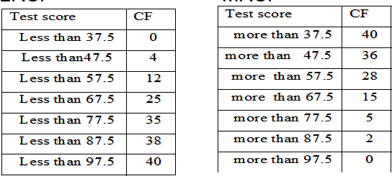
2. Cumulative Frequency Distribution (CFD):
It is applicable when we want to know how many observations lie below or above a certain value/class boundary.
CFD is of two types, LCFD and MCFD:
Less than Cumulative Frequency Distribution (LCFD): shows the collection of cases lying below the upper-class boundaries of each class.
More than Cumulative Frequency Distribution (MCFD): shows the collection of cases lying above the lower-class boundaries of each class.
LCFD MCFD

Slide 32
3. Relative Cumulative Frequency Distribution (RCFD):
It is used to determine the ratio or the percentage of observations that lie below or above a certain value/class boundary, to the total frequency of all the classes. These are of two types: The LRCFD and MRCFD.
Less than Relative Cumulative Frequency Distribution (LRCFD): A table presenting the ratio of the cumulative frequency less than upper class boundary of each class to the total frequency of all the classes
More than Relative Cumulative Frequency Distribution (MRCFD): A table presenting the ratio of the cumulative frequency more than lower class boundary of each class to the total frequency of all the classes.

Slide 33
LRCFD
MRCFD
Test Score | LCF | LRCF | LPCF
Less than 37.5 | 0 | 0 / 40 = 0 | 0%
Less than 47.5 | 4 | 4 / 40 = 0.1 | 10%
Less than 57.5 | 12 | 12 / 40 = 0.3 | 30%
Less than 67.5 | 25 | 25/40 = 0.625 | 62.5%
Less than 77.5 | 35 | 35/40 = 0.875 | 87.5%
Less than 87.5 | 38 | 38/40 = 0.95 | 95%
Less than 97.5 | 40 | 40/40 = 1 | 100%
Test Score | MCF | MRCF | MPCF
More than 37.5 | 40 | 40/40 = 1 | 100%
More than 47.5 | 36 | 36/40 = 0.9 | 90%
More than 57.5 | 28 | 28/40 = 0.7 | 70%
More than 67.5 | 15 | 15/40 = 0.375 | 37.55
More than 77.5 | 5 | 5/40 = 0.125 | 12.5%
More than 87.5 | 2 | 2/40 = 0.05 | 5 %
More than 97.5 | 0 | 0/40 = 0 | 0 %

Slide 34
Graphic Methods of Data presentation
Histogram
Frequency Polygon (Line graph)
Cumulative frequency curve (o-give)
Histogram: A graphical presentation of grouped frequency distribution consisting of a series of adjacent rectangles whose bases are the class intervals specified in terms of class boundaries (equal to the class width of the corresponding classes) shown on the x-axis and whose heights are proportional to the corresponding class frequencies shown on the y-axis.
Example:
Freq.
20
15
10
3-D Column 1
0
20 - 3030 - 4040 - 5050 - 6060 - 70 70 -80

Slide 35
Steps to draw Histogram
Mark the class boundaries on the horizontal axis (x- axis) and the class frequencies along the vertical axis ( y- axis) according to a suitable scale.
With each interval as a base draw a rectangle whose height equals the frequency of the corresponding class interval. It describes the shape of the data.
2. Frequency Polygon: It is a line graph of grouped frequency distribution in which the class frequency is plotted against class mark that are subsequently connected by a series of line segments to form line graph including classes with zero frequencies at both ends of the distribution to form a polygon.
Frequency Polygon:
20
15
10
Line1
5
0
20-30
30-40
40-50
50-60
60-70
70-80 80

Slide 36
Steps to draw Histogram
Mark the class mid points on the x-axis and the frequency on the y-axis.
Mark dots which correspond to the frequency of the marked class mid points.
Join each Join each successive dot by a series of line segments to form line graph, including classes with zero frequencies at both ends of the distribution to form a polygon.
3. O-GIVE curve (Cumulative Frequency Curve / percentage Cumulative Frequency Curve): It is a line graph presenting the cumulativefrequency distribution.
O-gives are of two types: The Less than O-give and the More than O-give.
The Less than O-give shows the cumulative frequency less than the upper-class boundary of each class and
The More than O-give shows the cumulative frequency more than the lower-class boundary of each class.

Slide 37
Ogive: E.g.
45
40
35
30
25
20
15
10
5
0
Line 1
Steps to draw O - gives
20 30 40 50 60 70 8 0
i. Mark class boundaries on the x-axis and mark non overlapping intervals of equal length on the y-axis to represent the cumulative frequencies.
i. For each class boundaries marked on the x-axis, plot a point with height equal to the corresponding cumulative frequencies.
iii. Connect the marked points by a series of line segments where the less than O-give is done by plotting the less than cumulative frequency against the upper-class boundaries

Slide 38
Diagrammatic Presentation Of Data
Bar charts
Pie chart
Pictograph and
Pare to diagram
Outline
Measures of Central Tendency
Measures of Dispersion
Measure of skewness and kurtosis

Slide 39
1.3 Measures of Central Tendency
Central value refers to the location of the center of the distribution of data.
Measure of central value:
The mean
The mode
The median
Percentile/Quantiles and
Midrange
T h e Mean: It is the most used measures of central value.
Types of Means: 1. Arithmetic Mean
2. Geometric Mean
3. Harmonic Mean
4. Quadratic Mean
5. Trimmed Mean
6. Weighted Mean
7. Combination mean

Slide 40
1. Arithmetic Mean
The mean is defined as the arithmetic average of all the values.
It is represented by x read as x-bar fora sample and by µ for a population
∑ m i
_{x =} i = 1
fc
∑ i
_{µ =} i = 1
N
Advantages
It is the most commonly used measure of location or central tendency for continuous variables.
The arithmetic mean uses all observations in the data set.
All observations are given equal weight.
Disadvantage
The mean is affected by extreme values that may not be representative of the sample.

Slide 41
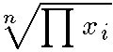
2. Geometric mean
It is the nth root of the product of the data elements.
It is used in business to find average rates of growth.
Geometric mean = r all n >=2.
Example: suppose
You have an R A
(Individual
Retirement Account) which earned annual interest
Rates of 5%, 10% and 25%
Solution: The proper Average would be the geometric mean or the cube root of (1.05 • 1.10 • 1.25) or about 1.13 meaning13%.
Note that the data elements must be positive. Negative growth is represented by positive values less than 1. Thus, if one of the accounts lost 5%, the proper multiplier would be0.95.

Slide 42
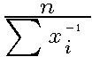
3. Harmonic mean
It is used to calculate average rates.
It is found by dividing the number of data elements by the sum of the reciprocals of each data element.
Harmonic mean =
Example: Suppose a boy rode a bicycle three miles. Due to the topography, for the first mile he rode 2 mph; for the second mile 3 mph; for the final mile the average speed was 4 mph. What was the average speed for the three miles? Solution: The arithmetic mean of (2+3+4)/3 = 3.0 is incorrect. This would imply it took 1 hour. Breaking it down into the separate components, it takes 30 minutes (1st) + 20 minutes (2nd) + 15 minutes (3rd) to walk (each mile) or 65 minutes total. His actual speed was thus 3/1.083 or 2.77mph.
Another way toshow our work would be:
3 miles = 1/2+1/3+1/4
3 . = 13/12
36 = 2.77mph
13

Slide 43
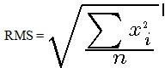
Quadratic mean
It is another name for Root Mean Square or RMS.
RMS is typically used for data whose arithmetic mean is zero.
Example
Suppose measurements of 120, -150, and 75 volts were obtained.
Solution: The corresponding quadratic mean is
√((120²+ (-150)² + 75²)/3) or 119 volts RMS.
The quadratic mean gives a physical measure of the average distance from zero.

Slide 44
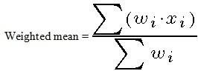
Trimmed mean
It usually refers to the arithmetic mean without the top 10% and bottom 10% of the ordered scores;
Removes extreme scores on both the high and low ends of the data.
A truncated mean or trimmed mean
6. Weighted mean
It is the average of differently weighted scores;
It takes into account some measure of weight attached to different scores.

Slide 45
The Mode
The mode is the most frequent or most typical value.
The mode will not always be the central value; infact it may sometimes be an extreme value. Also, a sample may have more than one mode.
Bimodal or Multimodal
Example
‘23, 22, 12, 14, 22, 18, 20, 22, 18, 18’ - The mode is 18 and 22 - bimodal
Advantages
Requires no calculations.
Represents the value that occurs most often.
Disadvantage
The mode for continuous measurements is dependent on the grouping of the intervals.
We may not have mode

Slide 46
The Median:
The median is the middle value of a group of an odd number of observations when the data is arranged in increasing or decreasing order magnitude.
If the number of values is even, the median is the average of the two middle values.
Example: ‘23, 22, 12, 14, 22, 18, 20, 22, 18, 18’
Array: 12, 14, 18, 18, 18, 20, 22, 22,22,23. The median (18+20)/2 = 19
Advantages
The median always exists and is unique.
The median is not affected by extreme values.
Disadvantages
The values must be sorted in order of magnitude.
The median uses only one (or two) observations

Slide 47
Percentiles / Quartiles:
Percentiles are values that divide a distribution into two groups where the Pth percentile is larger than P% of the values.
Some specific percentiles have special names:
First Quartile : Q1= the 25percentile
Median : Q2= the 50 percentile
Interpretation:
Q1= a. This means that 25% of the data values are smaller than a
Q₂= b. This means that 50 %of the data has values smaller than b.
Q₃= c. This means that 75 %of the data has values smaller than c.
Midrange
The midrange is the average of largest and smallest observation.
Midrange = (Largest +Smallest)/2
The percentile estimate (P25 + P75)/2 is sometimes used when there are a large number of observations.

Slide 48
1.4. Measure of Dispersion (of Variability)
A measure of dispersion indicates how the observations are spread about the central value.
Measure of Dispersion are:
The Range
The variance
The Standard Deviation and
The Coefficient Variation
The Range:
The range is the difference between the largest and the smallest value in the sample.
The range is the easiest of all measures of dispersion to calculate.
R= Maximum Value - Minimum Value
Advantages
The range is easily understood and gives a quick estimate of dispersion.
The range is easy to calculate
Disadvantages
The range is inefficient because it only uses the extreme value and ignores all other available data. The larger the sample size, the more inefficient the range becomes.

Slide 49
The Variance:
The variance is the mean square deviation of the observations from the mean. To calculate the variance, the following equation issued:
∑
fi *(m−x)
i
n−1
s² =σ2=
Advantages:
The variance is an efficient estimator
Variances can be added and averaged
Disadvantage
The calculation of the variance can be tedious without the aid of a calculator or computer

Slide 50
The Standard Deviation:
The square root of the variance is known as the standard deviation. The symbol for the standard deviation is s.
_{s}2
s =
Advantages:
The standard deviation is in the same dimension as the observed values.
The standard deviation is an efficient estimator
Disadvantage
The calculations can be tedious without the aid of a good calculator

Slide 51
The coefficient of variation:
The coefficient of variation is a measure of relative dispersion, that is, a measure which expresses the magnitude of the variation to the size of the quantity that is being measured and is expressed as a percent.
CV =(s / x)*100
Advantages:
Thr coefficient of variation can be used for comparing the variation in different populations of data that are measured in two different units. (because the CV is unitless)
Disadvantage
The coefficient of variation fails to be useful when x is close to zero.
The coefficient of variation is often misunderstood and misused.

Slide 52
The Interquartile range: it is the difference between the 25th and the 75th quartiles.
Interquartile range = Q3 – Q1

Slide 53
Measure of skewness and kurtosis Skewness(mean deviation):
Skewness is a measure of the tendency of the deviations to be larger in one direction than in the other.
Skewness is the degree of asymmetry or departure from symmetry of a distribution.
If the frequency curve of a distribution has a longer tail to the right of the central value than to the left, the distribution is said to be skewed to the right or to have positive skewness.
If the reverse is true, it is said that the distribution is skewed to the left or has negative skewness.

Slide 54
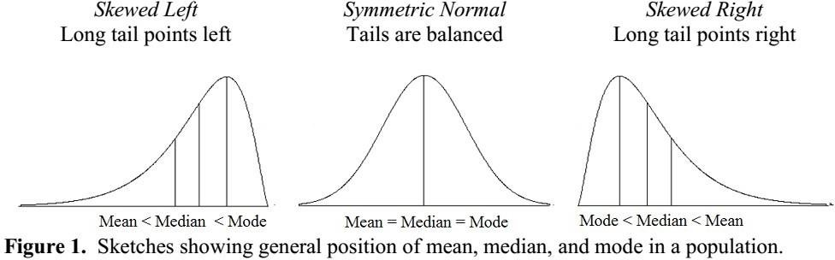

Slide 55
Population skewness is defined as
E ( x − μ ) ³
_{σ} 3
where E stands for expected value
Abe l-shaped distribution which has no skewness, i.e., mean
median = mode is ca led a normal distribution.
If mean > Median > mode, the distribution is positively skewed distribution, or it is said to be skewed to the right.
If mean < Median < mode, the distribution is negatively skewed distribution, or it is said to be skewed to the left.

Slide 56
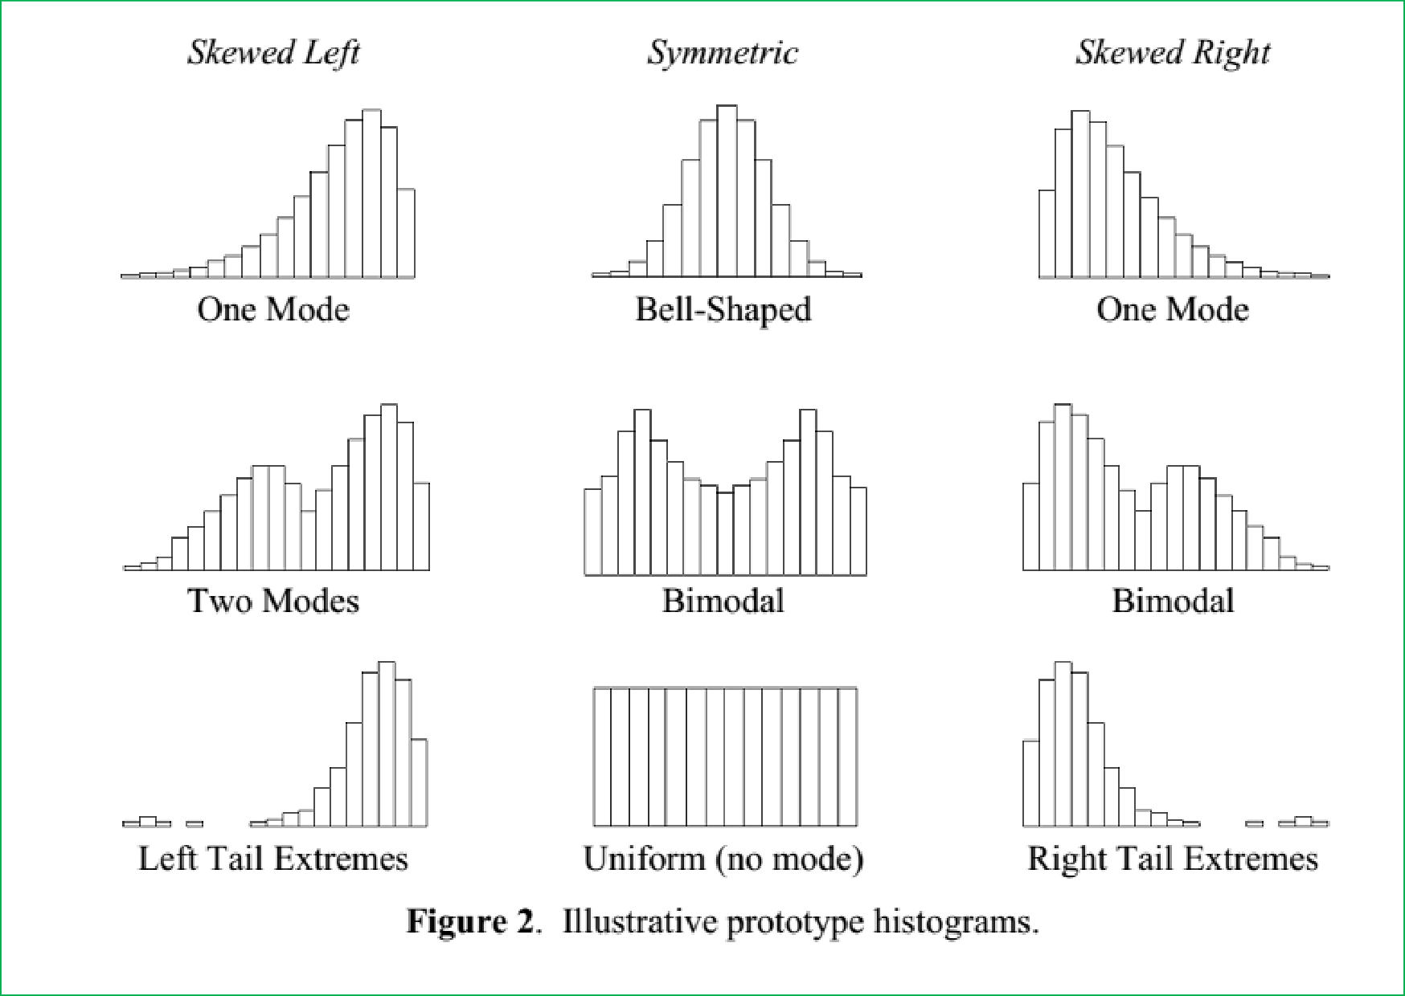

Slide 57
Measure of kurtosis
Kurtosis characterizes the relative peakedness or flatness of a distribution compared with the normal distribution.
Positive kurtosis indicates a relatively peaked distributions.
Negative kurtosis indicates a relatively flat distribution.
The population kurtosis is usually defined as:
E(x −μ)⁴
Nσ⁴
−3

Slide 58
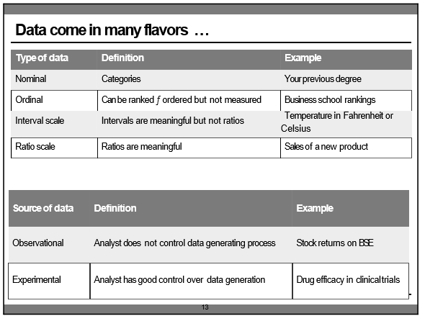

Slide 59
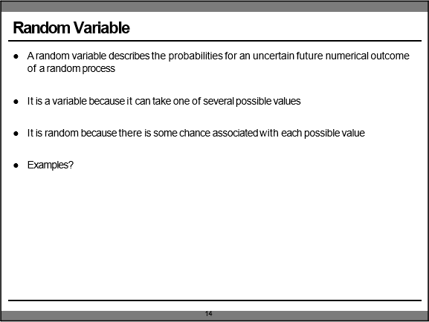

Slide 60
Probability Distribution: Discrete and Continuous:
Probability:
Long run average of random event occurring
Different from subjective beliefs
A probability distribution is a rule that identifies possible outcomes of a random variable and assign a probability to each
A discrete distribution has a finite number of values
- e.g. Face value of a card, work experience of students rounded off to nearest month
A continuous distribution has all possible values in some range
- e.g. sales per month, height of students in this class
continuous distribution are nicer to deal with and are good approximations when there are a large number possible values

Slide 61
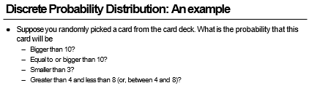

Slide 62
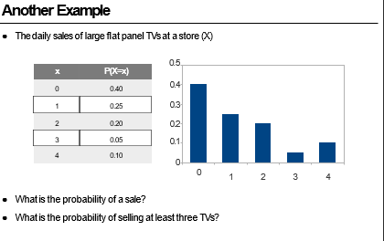

Slide 63
Expected Value or Mean:
The expected value or mean (μ) od a random variable is the weighted average of the values
- the Probabilities serve as weights
E(X) = ∑x ₁ P (X = x ₁ )
What is the mean number of TVs sold per day?
What does this number imply?

Slide 64
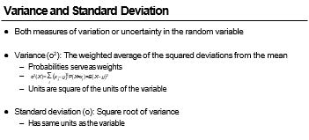

Slide 65
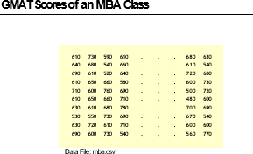

Slide 66
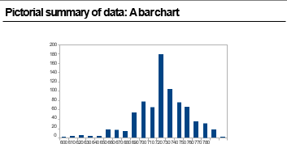

Slide 67
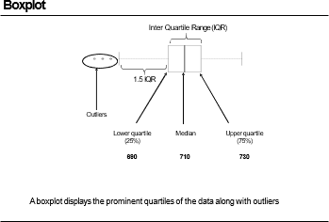

Slide 68
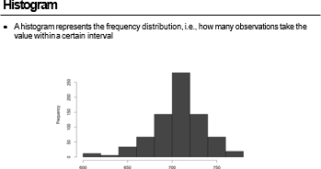

Slide 69
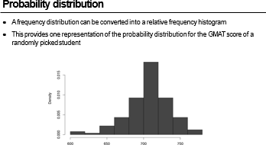

Slide 70
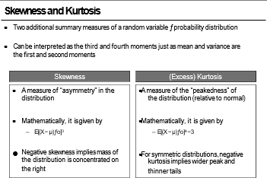

Slide 71
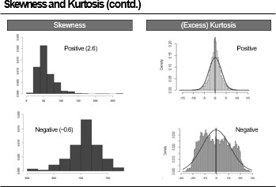

Slide 72
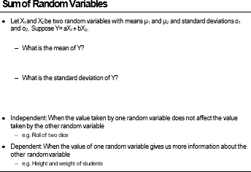

Slide 73
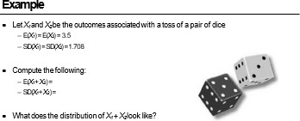

Slide 74
Summary of Session:
A Random variable describes the probabilities for an uncertain further numerical outcome of a random process
A probability distribution is a rule that identifies possible outcomes of a random variable and assigns a probability to each
The expected value f Mean of a random variable is the weighted average of its values
Variance is the weighted average of the squared deviations from the mean
A probability distribution can be pictorially represented by a histogram, box-plot, probability density function
Expected value of the sum of random variables is the sum of expected values of a individual random variables
Same rule applies to variance only if the variables are independent

